Slide 1
CS 3006 Parallel and Distributed Computing Lecture 12
Danyal Farhat
FAST School of Computing
NUCES Lahore

Slide 2
Synchronization Constructs in OpenMP – Part 2

Slide 3
Outline
Loop Worksharing Construct
Numerical Integration: Pi program
Serial Pi Program
Parallel Pi Program
Parallel Pi Program using Mutual Exclusion
Pi Program using Reduction Clause
Sections Constructs
Combined Constructs

Slide 4
Outline (Cont.)
Synchronization Locks
The Schedule Clause
Runtime Environment Routines
Summary
Additional Resources

Slide 5
Loop Worksharing Construct
Sequential Code
OpenMP Parallel Region
OpenMP parallel region and a worksharing for construct
for(i=istart;I<iend;i++) { a[i] = a[i] + b[i];}
#pragma omp parallel
{
int id, i, Nthrds, istart, iend;
id = omp_get_thread_num();
Nthrds = omp_get_num_threads();
istart = id * N / Nthrds;
iend = (id+1) * N / Nthrds;
for(i=start;i<iend; i++) {a[i] = a[i] + b[i];}
}
#pragma omp parallel
#pragma omp for
for(i=0;I<N;i++) {
a[i] = a[i] + b[i];}
Notes:
Section 7.10

Slide 6
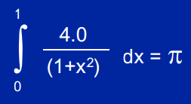
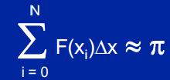
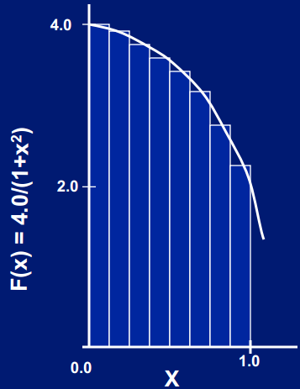
Numerical Integration: Pi program
Mathematically
Integral can be approximated as a sum of rectangles:
Where each rectangle has
width Δx and height F(xi) at
the middle of interval i.
Source: http://openmp.org/mp-documents/omp-hands-on-SC08.pdf
Notes:
We want to integrate function 4.0 / (1 + x*x). The exact integral of this function is equal to Pi.
We know that integration is the area under the curve. Thus, we can use summation as integration.

Slide 7
Serial Pi Program
static long num_steps = 100000; // total rectangles
double step;
void main ()
{
int i; double x, pi, sum = 0.0;
step = 1.0/(double) num_steps; // size of one rectangle
for (i=0;i< num_steps; i++){
x = (i+0.5)*step; // rectangle width
sum = sum + 4.0/(1.0+x*x); // rectangle area // integrating area
}
pi = step * sum;
}

Slide 8
Parallel Pi Program
static long num_steps = 100000;
double step;
#define NUM_THREADS 4
int _tmain(int argc, _TCHAR* argv[])
{
int i, nthreads;
double pi, sum[NUM_THREADS];
step = 1.0/(double) num_steps;
omp_set_num_threads(NUM_THREADS); // Setting number of threads

Slide 9
Parallel Pi Program (Cont.)
#pragma omp parallel
{
int i, id, nthrds;
double x;
id = omp_get_thread_num(); // Getting thread Id (Unique Id for each thread)
nthrds = omp_get_num_threads(); // Number of threads in the program
if(id == 0)
nthreads = nthrds;
for (i=id, sum[id]=0.0;i< num_steps; i=i+nthrds){
x = (i+0.5)*step; // rectangle width
sum[id] += 4.0/(1.0+x*x); // array with partial sum of each thread
}
}

Slide 10
Parallel Pi Program (Cont.)
for(i=0,pi=0.0; i<nthreads; i++)
pi += sum[i] * step;
printf("%f\n", pi);
return 0;
}

Slide 11
Parallel Pi Program using Mutual Exclusion
static long num_steps = 100000;
double step;
#define NUM_THREADS 4
int _tmain(int argc, _TCHAR* argv[])
{
int i, nthreads;
double pi, sum[NUM_THREADS];
step = 1.0/(double) num_steps;
omp_set_num_threads(NUM_THREADS); // Setting number of threads

Slide 12
Parallel Pi Program using Mutual Exclusion (Cont.)
#pragma omp parallel
{
int i, id, nthrds;
double x;
id = omp_get_thread_num(); // Getting thread Id (Unique Id for each thread)
nthrds = omp_get_num_threads(); // Number of threads in the program
if(id == 0)
nthreads = nthrds;
for (i=id, sum[id]=0.0;i< num_steps; i=i+nthrds){
x = (i+0.5)*step; // rectangle width
sum[id] += 4.0/(1.0+x*x); // array with partial sum of each thread
}
}

Slide 13
Parallel Pi Program using Mutual Exclusion (Cont.)
#pragma omp critical // Ensuring Mutual Exclusion
pi += (sum * step);
}
printf("%f\n", pi);
}

Slide 14
Pi Program using Reduction Clause
static long num_steps = 100000;
double step;
void main () {
int i; double pi, sum = 0.0;
step = 1.0/(double) num_steps;
#pragma omp parallel {
double x;
#pragma omp for reduction(+:sum) // reduction (op : list) is equivalent to reduction (+:sum)
for (i=0;i< num_steps; i++){
x = (i+0.5)*step;
#pragma omp critical
sum = sum + 4.0/(1.0+x*x);
} }
pi = step * sum;
}

Slide 15
Sections Constructs
#pragma omp parallel
{
#pragma omp sections
{
#pragma omp section
(void) funcA(); // x-calculation
#pragma omp section
(void) funcB(); // y-calculation
} /*-- End of sections block --*/
} /*-- End of parallel region --*/

Slide 16
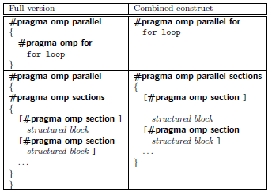
Combined Constructs

Slide 17
Synchronization Locks
omp init lock()
omp set lock()
omp_unset_lock()
omp_test_lock()
omp_destroy_lock()

Slide 18
The Schedule Clause
Static:
Pre-determined and predictable by the programmer
Scheduling done at compile time
Least work at runtime
Dynamic:
Unpredictable and mostly used when task size is unknown
Complex scheduling used at run-time
Most work at runtime

Slide 19
The Schedule Clause (Cont.)
Guided:
Special case of dynamic to reduce scheduling overhead
Larger chunks are selected at start and then its size is reduced to get better distribution
Runtime:
Scheduling technique could be selected at runtime by using this clause

Slide 20
Runtime Environment Routines
Modify/Check the number of threads
omp_set_num_threads(), omp_get_num_threads(),
omp_get_thread_num(), omp_get_max_threads()
Are we in an active parallel region?
– omp_in_parallel()
How many processors in the system?
– omp_num_procs()
Nested Parallelism
Om_set_nested(1)
Omp_set_max_active_levels()

Slide 21
Summary
Loop Worksharing Construct
Numerical Integration: Pi program
Serial Pi Program
Parallel Pi Program
Use of omp_set_num_threads, #pragma omp parallel, and omp_get_num_threads
Parallel Pi Program using Mutual Exclusion
Use of #pragma omp critical
Pi Program using Reduction Clause
Use of #pragma omp for reduction(+:sum)

Slide 22
Summary (Cont.)
Sections Constructs
Combined Constructs
Synchronization Locks
The Schedule Clause
Static, Dynamic, Guided and Runtime
Runtime Environment Routines

Slide 23
Additional Resources
Introduction to Parallel Computing by Ananth Grama and Anshul Gupta
Chapter 7: Programming Shared Address Space Platforms
Introduction to OpenMP by Tim Mattson (Intel)
https://www.youtube.com/watch?v=nE-xN4Bf8XI&list=PLLX-Q6B8xqZ8n8bwjGdzBJ25X2utwnoEG&index=1

Slide 24
Questions?

